Slide 1
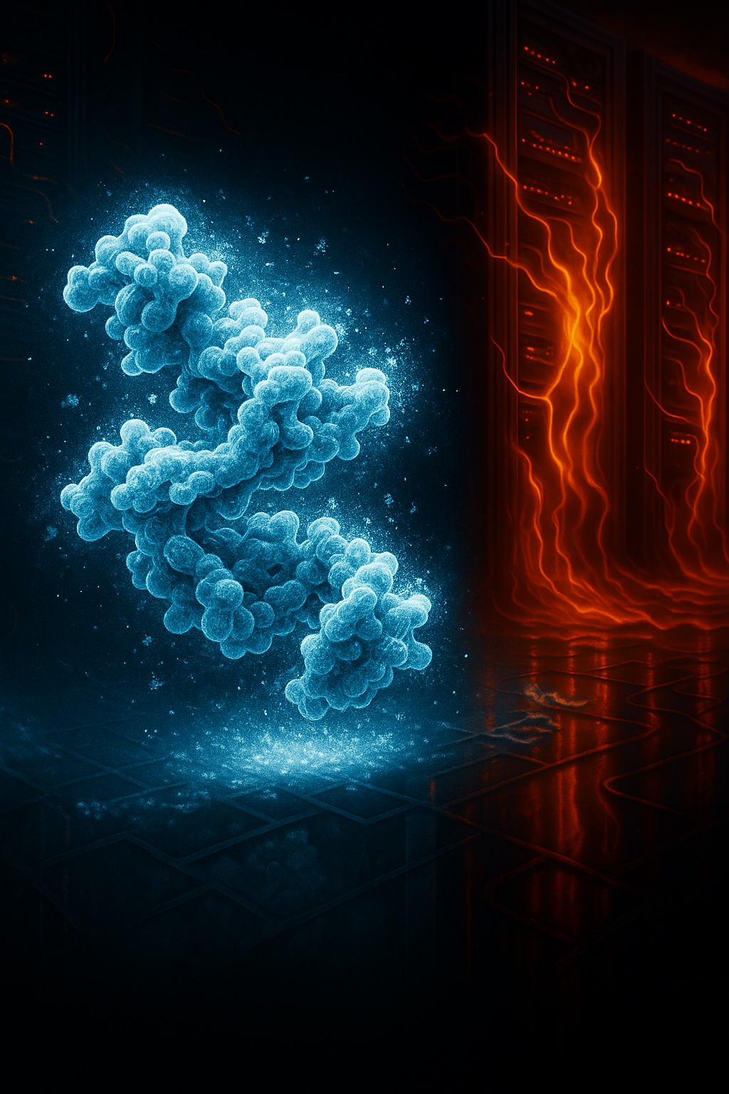
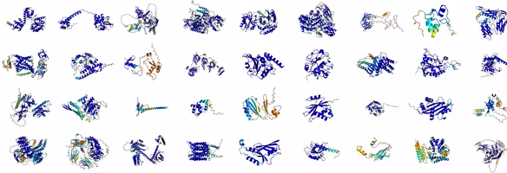
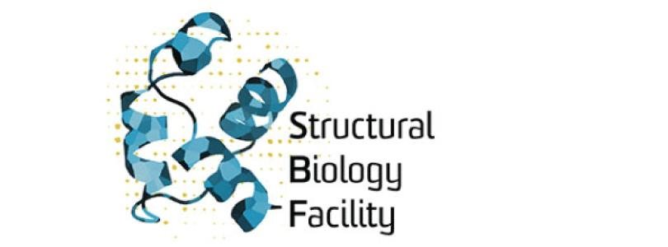

Frozen Samples, Melting Servers:
The CryoEM and AlphaFold data explosion
Research Data Experience Seminar – 2025 July 9th
Dr Daniel Luque & Dr Keiran Rowell​

Slide 2
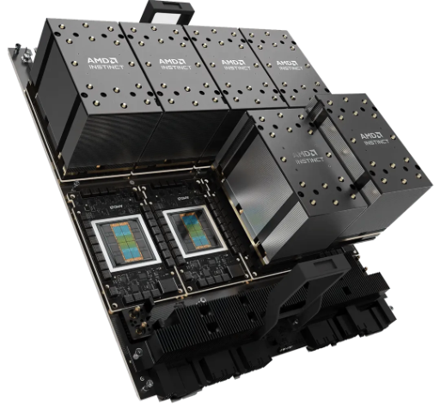
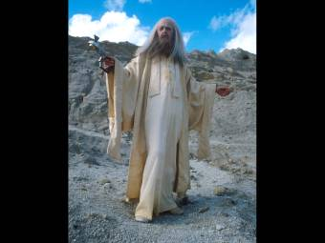


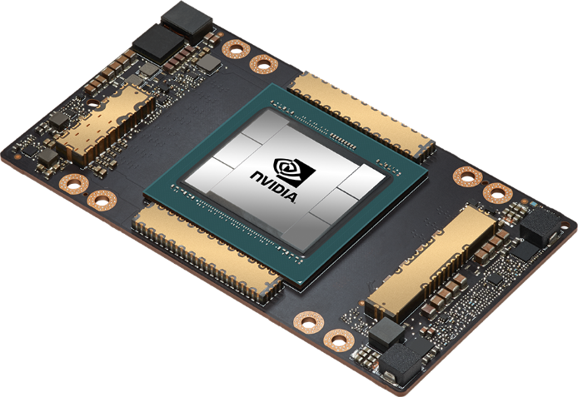
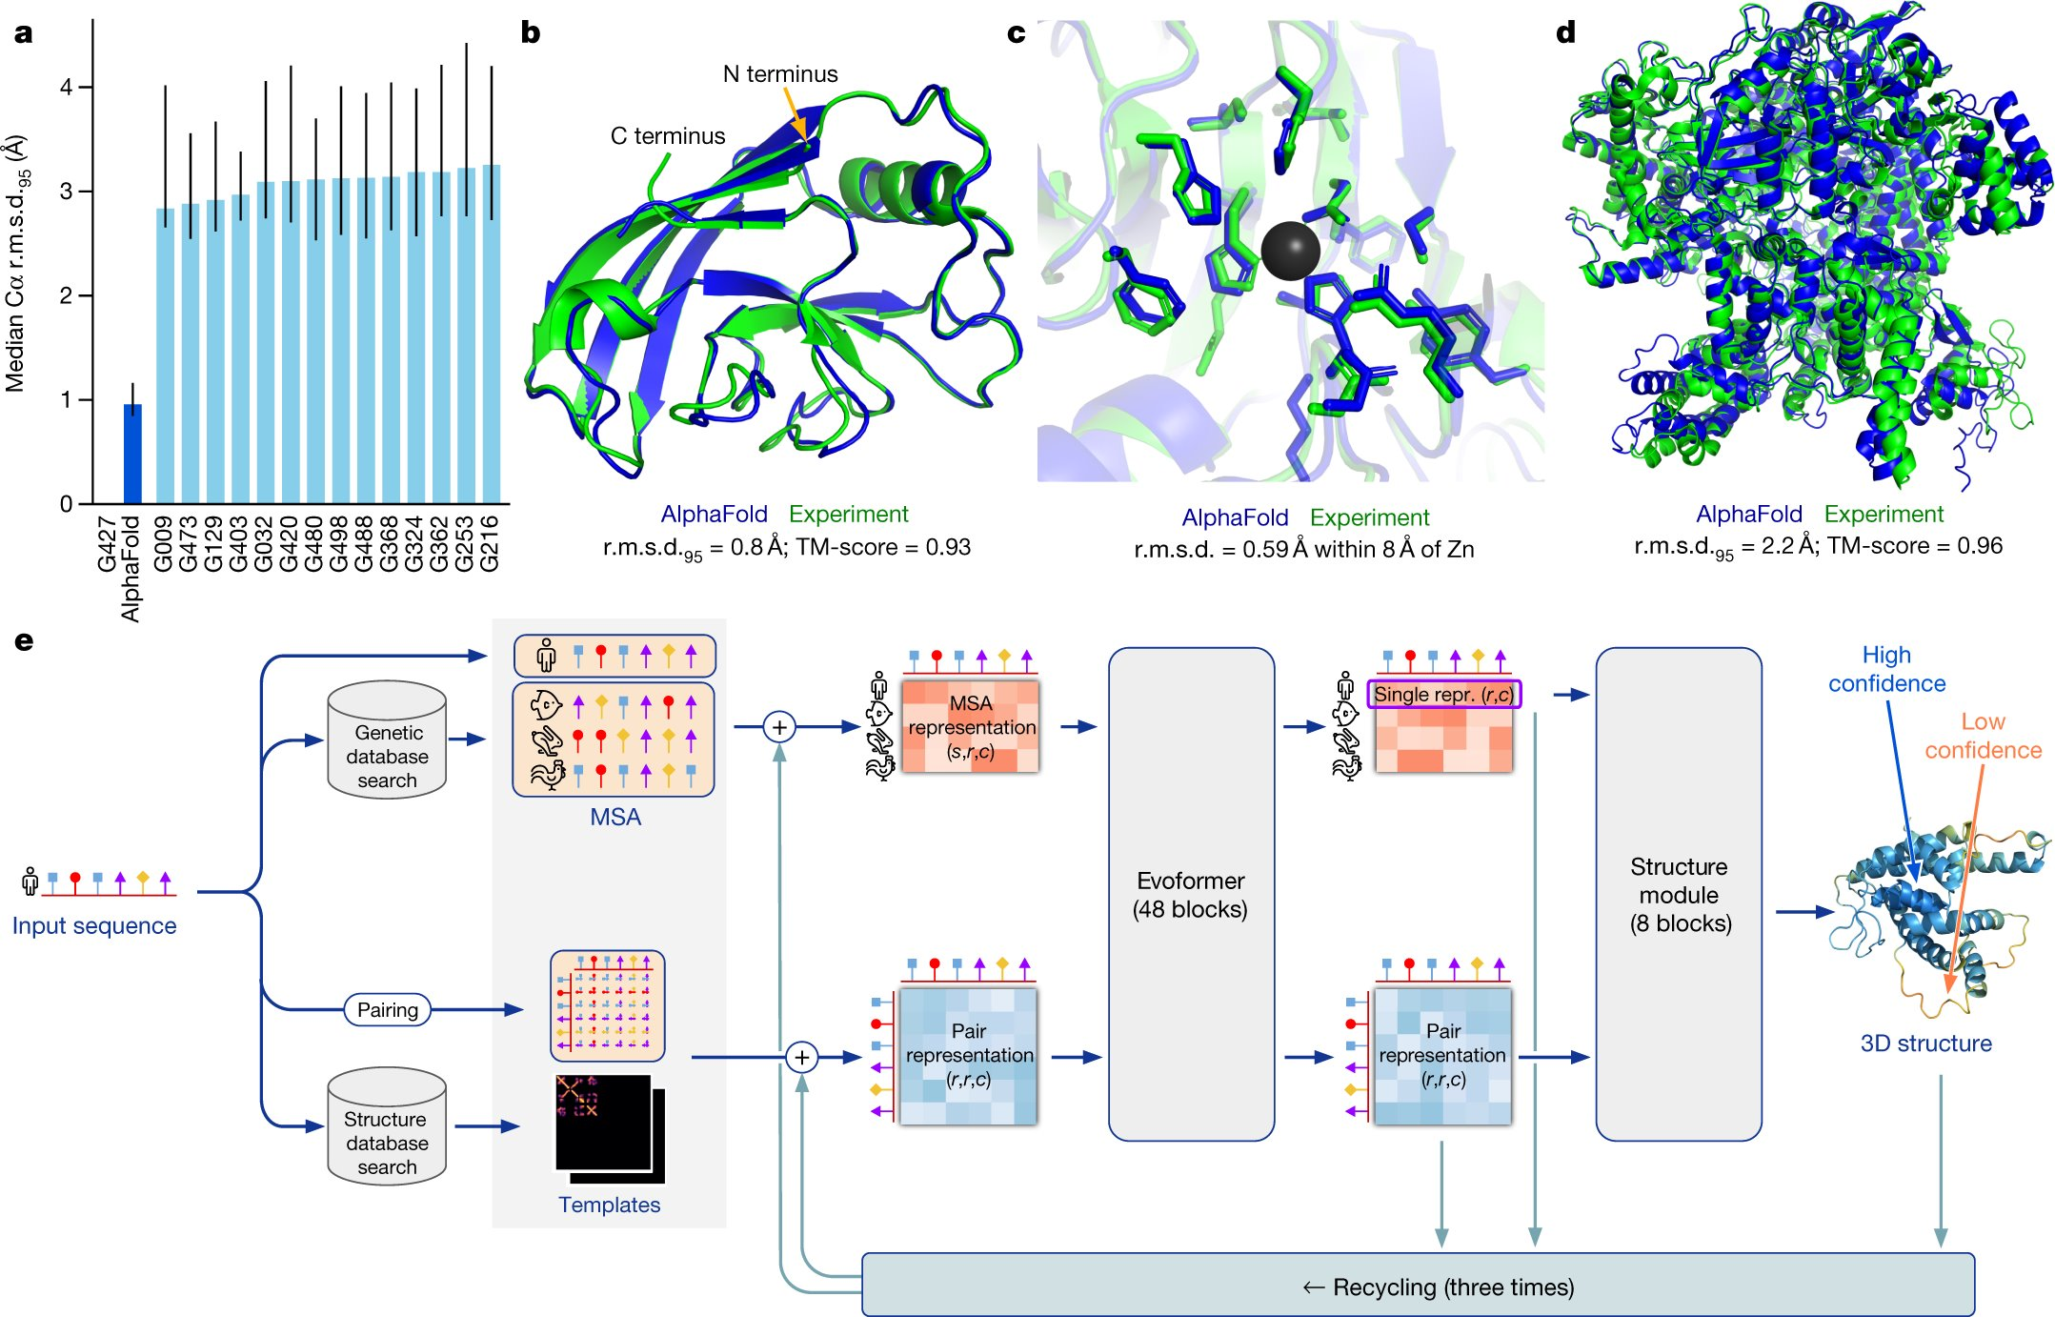
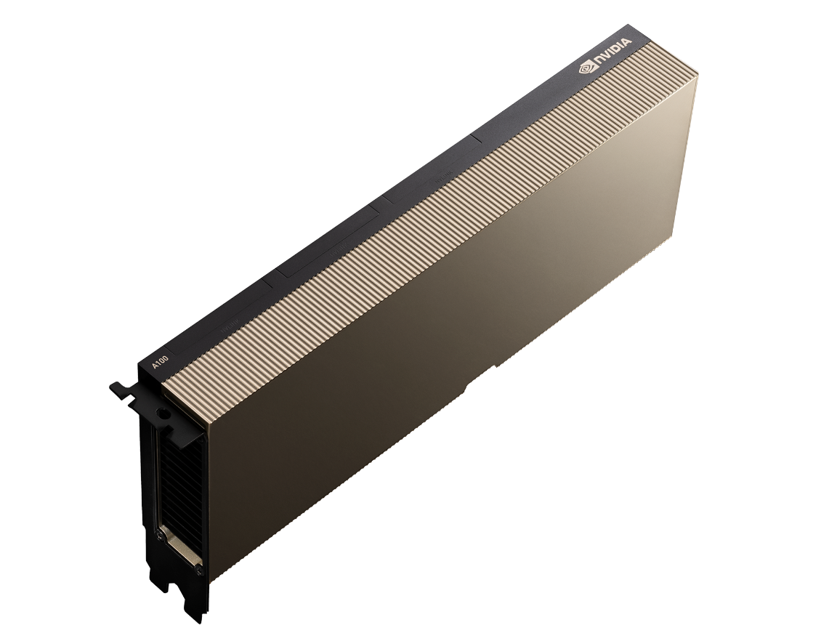

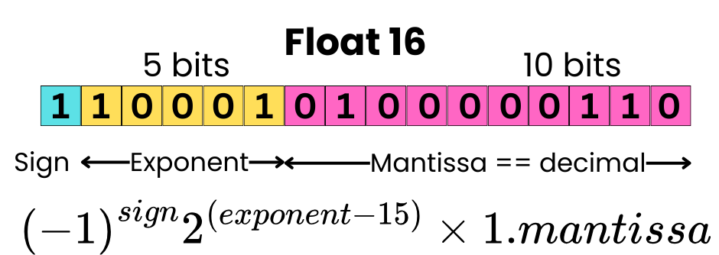
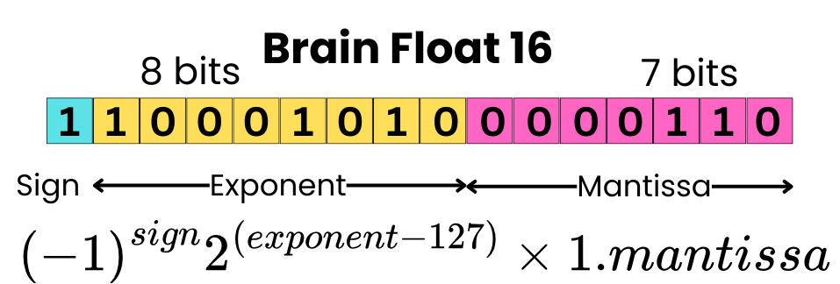
AlphaFold – AI workloads backed by large biodatabases
SBF nodes:
k099 & k100 (Slarti & Bartfast)
4xH200 GPU (141 GB VRAM), 7.3&5.1/11 TB local NVMe
k095 (Trillian) & Zaphod (DevOps test server)
4xA100 GPU (40 GB VRAM), 4.9/5.3 TB local NVMe
Fig. 1: AlphaFold produces highly accurate structures – from "Highly accurate protein structure prediction with AlphaFold" - Nature, 596, 583-89 (2021).
Slow..
GPU intensive
Brainfloat-16 (bfloat16)
Float32 vs Float16 vs BFloat16? : https://newsletter.theaiedge.io/p/float32-vs-float16-vs-bfloat16

Slide 3
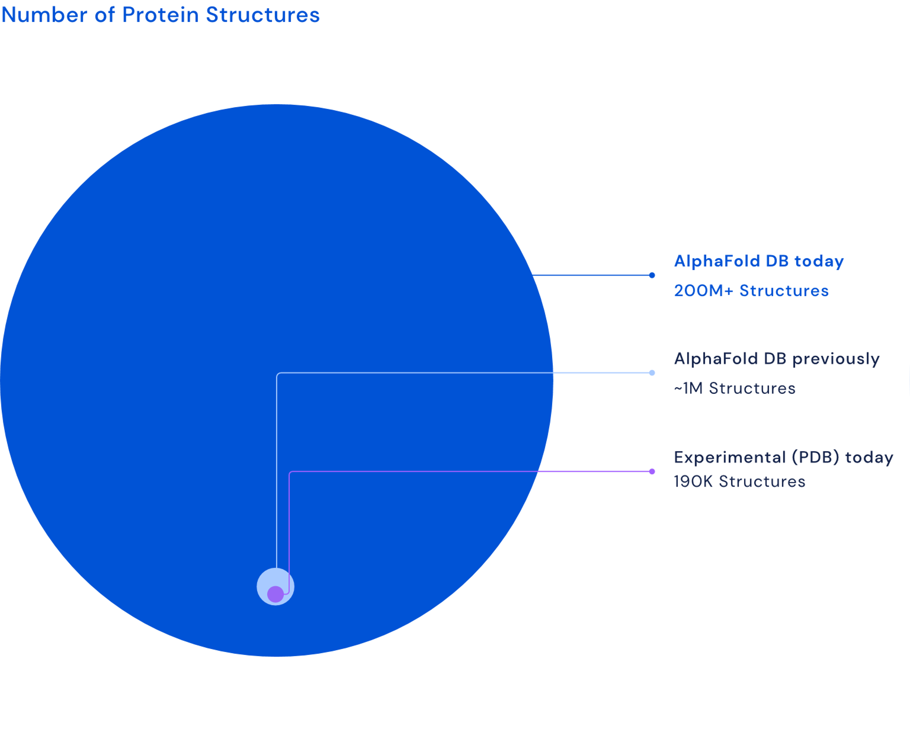





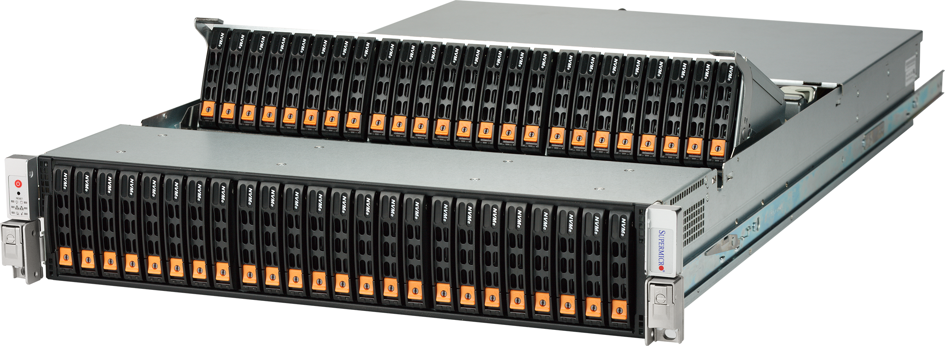
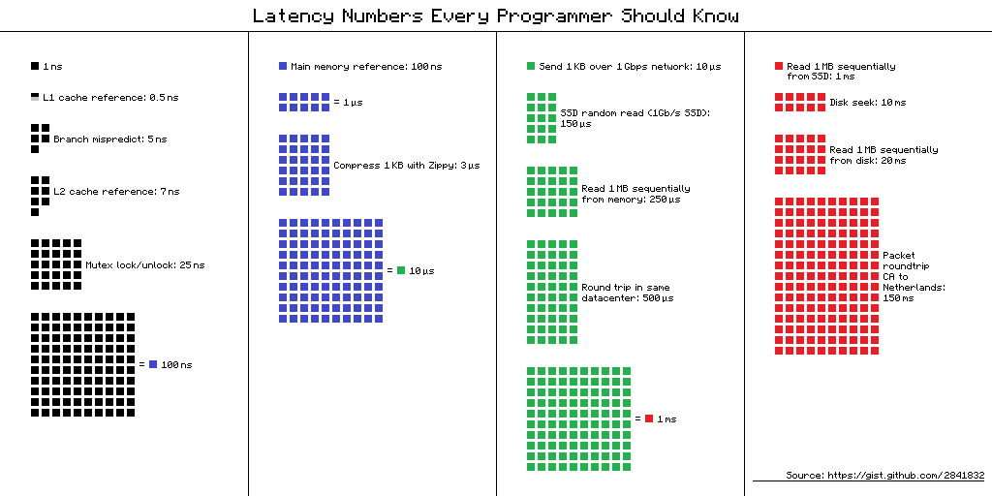
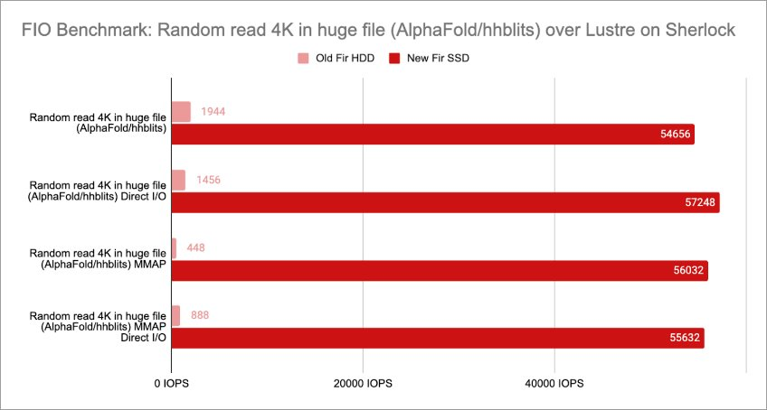

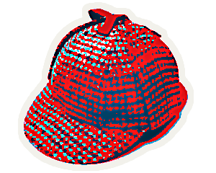
AlphaFold – I/0 matters – 4 TB DBs – mind your nanoseconds
200,000 experimentally resolved structures
2.5 billion genetic sequences
https://bfd.mmseqs.com/
www.rcsb.org (Protein DataBank)
https://news.sherlock.stanford.edu/publications/sherlock-goes-full-flash

Slide 4
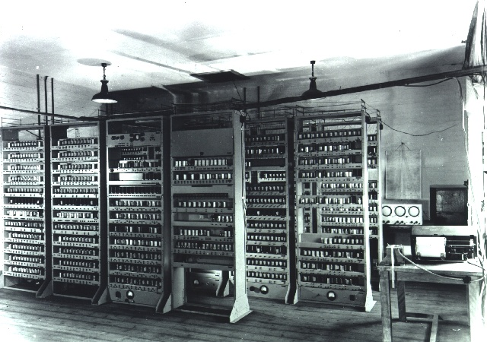
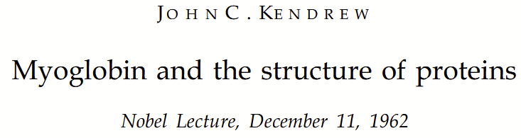
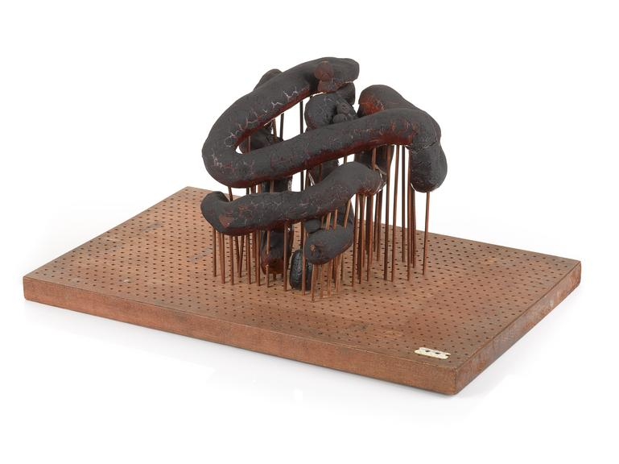
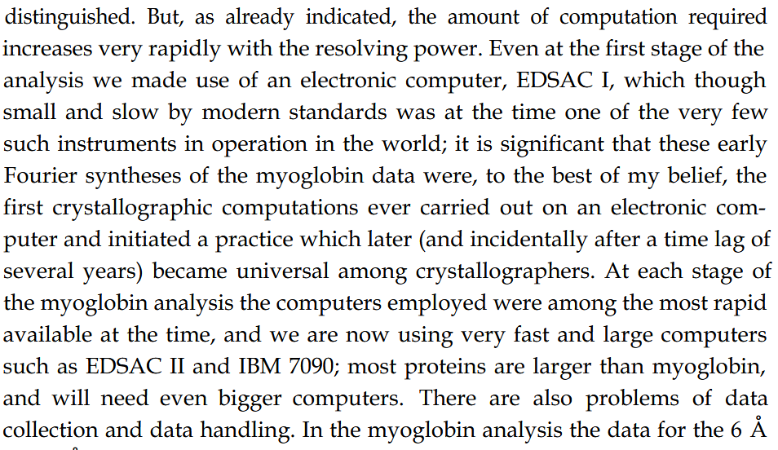
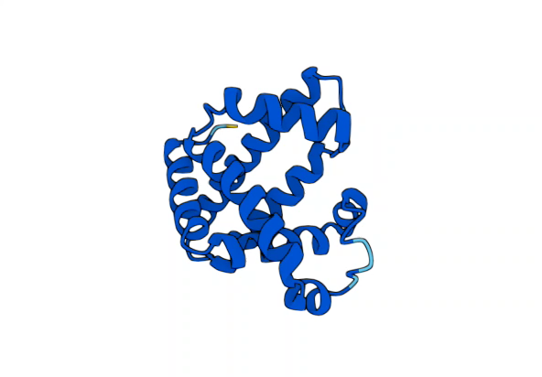
It was ever thus... biomolecules & computers
Wikimedia Commons: EDSAC I, June 1948.
Copyright Computer Laboratory, University of Cambridge. Reproduced by permission.
Incidentally, John Lennard-Jones (KBE, FRS) founding Dir. of the Mathematical Laboratory in Cambridge
->
Department of Computer Science and Technology
->
built EDSAC under second Dir. Maurice Wilkes (FRS, FREng)
Science Museum Group Collections: The original model of the myoglobin molecule.
Copyright The Board of Trustees of the Science Museum, London
AlphaFold Protein Structure Database: Myoglobin, AF-P02168-F1-v4, 2022-11-01, AlphaFold2.0

Slide 5
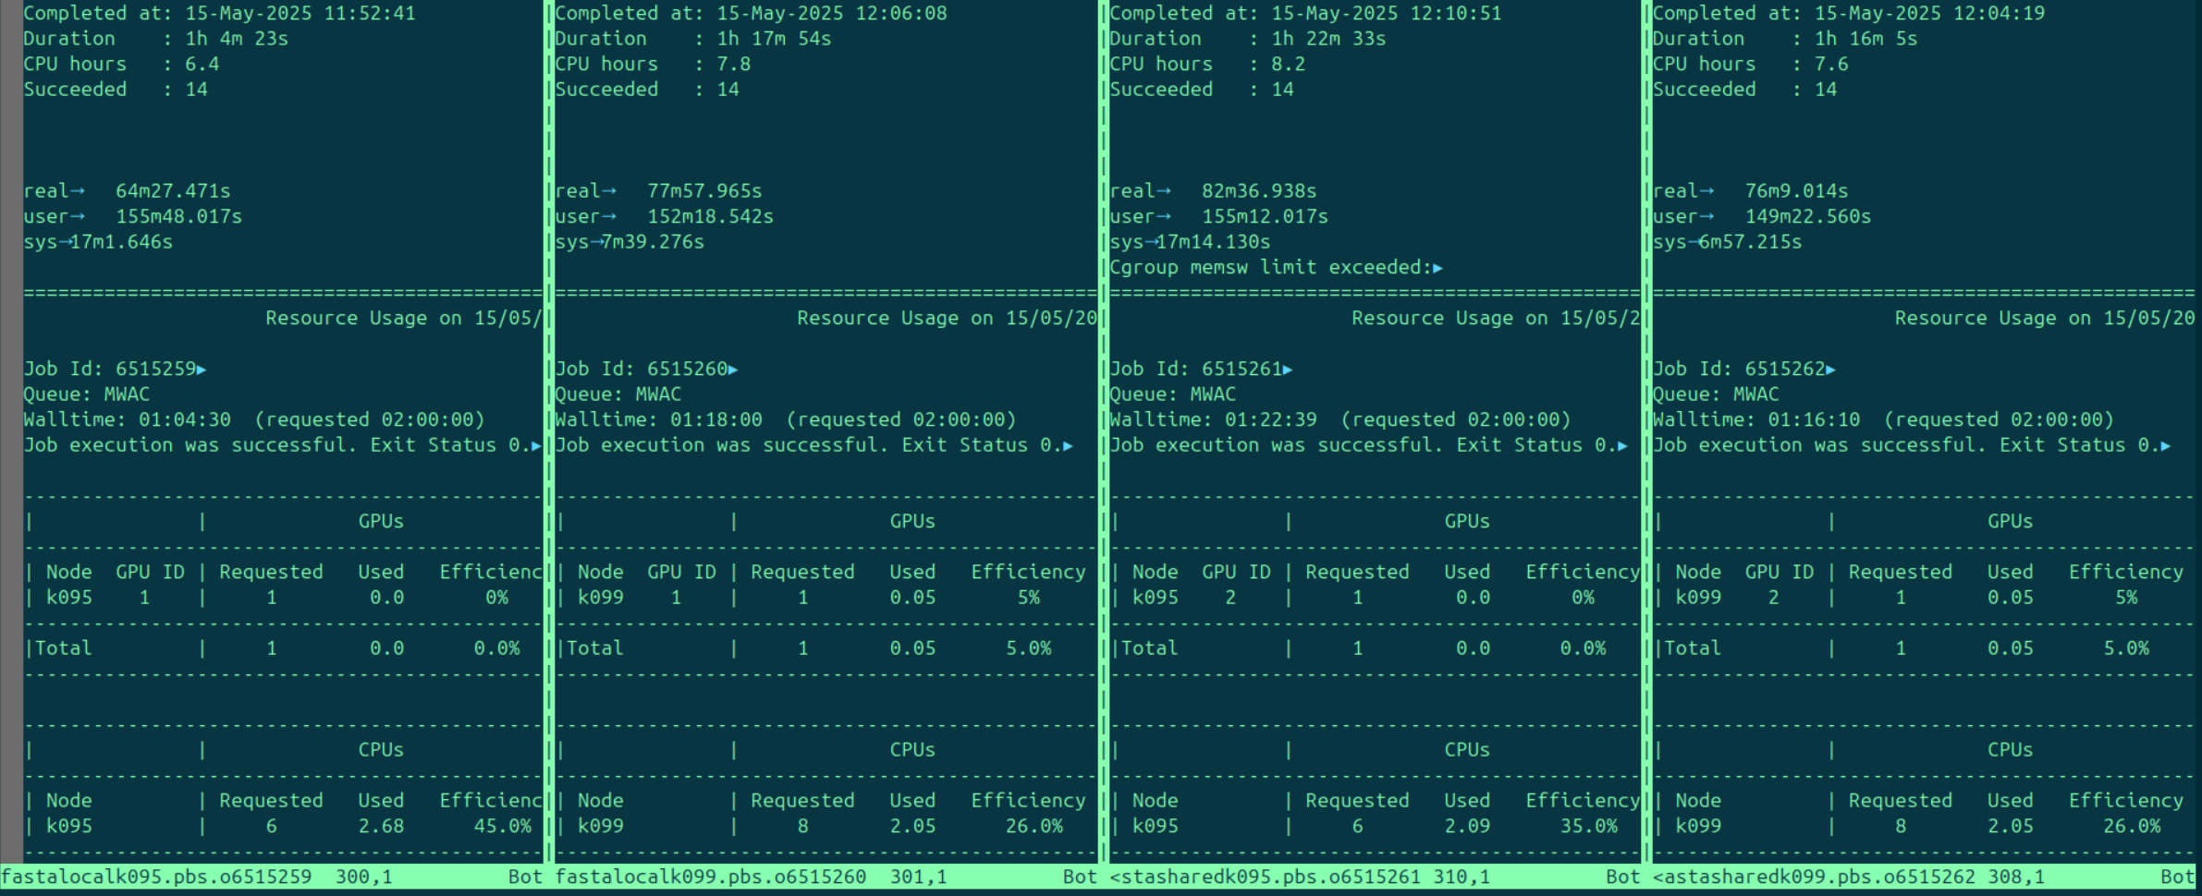
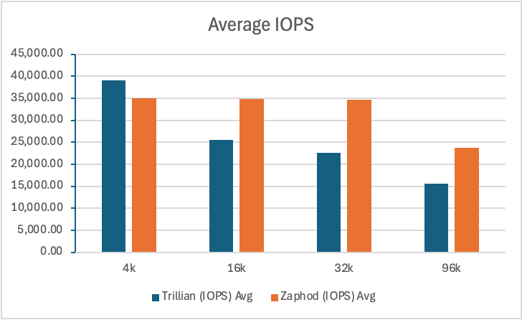
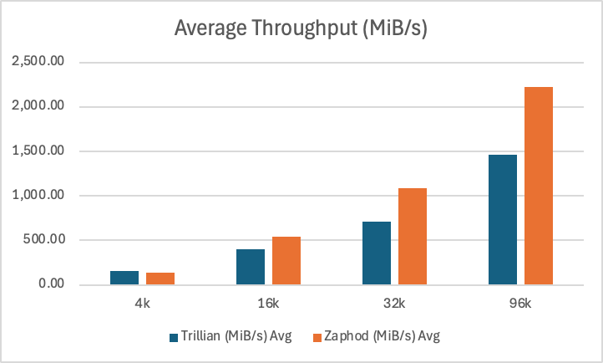
AlphaFold – benchmarking – node-local vs scratch
Job batching is super important!
Single input search
1 c4/1c6a0b 6660576.kman.restech.unsw.edu.au NFCORE_PROTEINFOLD:BOLTZ:MSA:MMSEQS_COLABFOLDSEARCH (input_seqs_1) COMPLETED 0 2025-07-01 21:01:02.408 1h 45m
1h 45m 15s 686.4% 240.4 GB 268.4 GB 52.6 MB 88.5 MB
Batch search (21 proteins)
1 93/9c23a7 6660292.kman.restech.unsw.edu.au
NFCORE_PROTEINFOLD:BOLTZ:MSA:MMSEQS_COLABFOLDSEARCH
(input_seqs_1) CACHED 0 2025-07-01 18:38:12.660 1h 52m
1h 51m 20s 585.1% 241.2 GB 428.6 GB 93.2 MB 623.3 MB
Credit Tom Litfin: senior research associate @ SBF
Mass scratch vs local
Credit Josh Caley: computational systems officer @ SBF
Disk striping
MDADM (Trillian) vs
ZFS (Zaphod)
--direct=1
--rw=randread
--bs=${BLOCK_SIZE}
--iodepth=256
--runtime=120
--numjobs=4
Credit N.: computational systems officer @ SBF

Slide 6

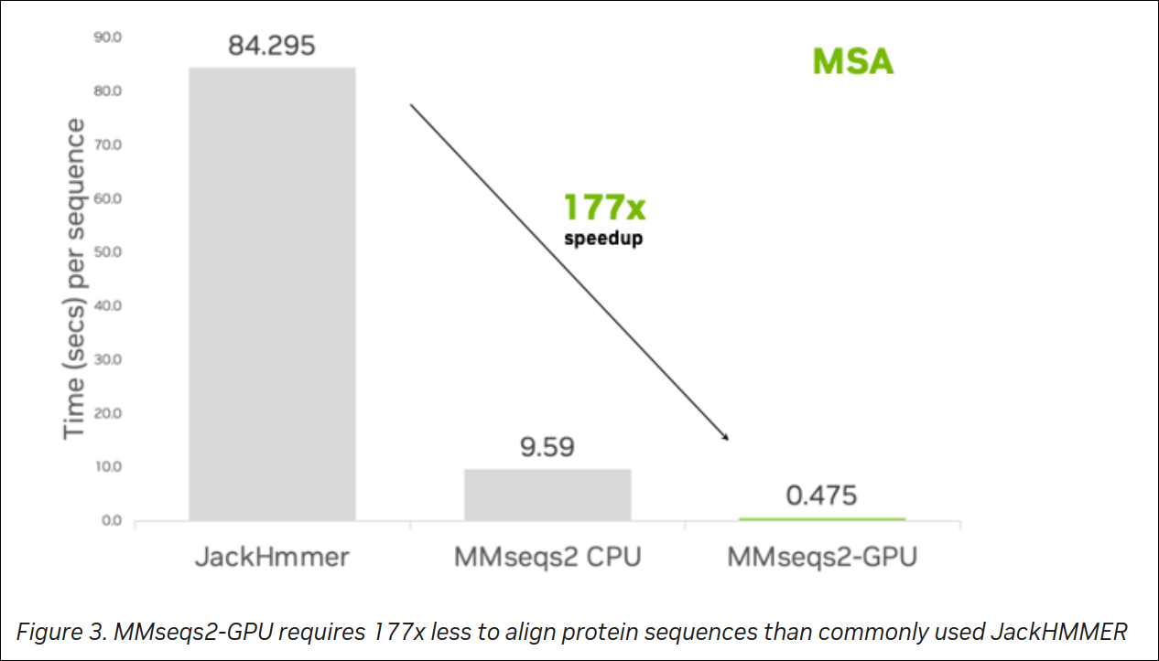

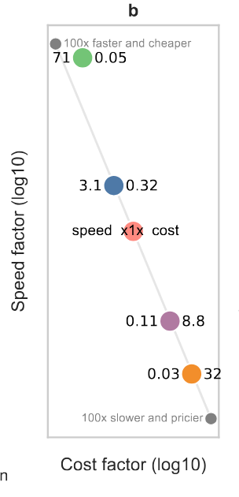
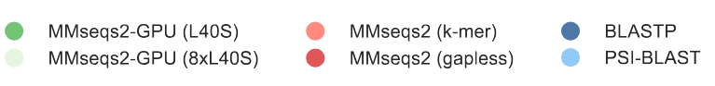
GPU accelerated sequence alignment
_{mmseqs.com}
_{mmseqsDownUnder?}
NVIDIA dev blog 2024-11-13: https://developer.nvidia.com/blog/boost-alphafold2-protein-structure-prediction-with-gpu-accelerated-mmseqs2/
(b) For single-batch processing, MMseqs2-GPU delivers the fastest speed at lowest cloud compute cost, being 71 times faster than MMseqs2 k-mer at 0.05 times the cost.
(c) Faster folding speeds at no accuracy cost. On 20 CASP14 targets, ColabFold leveraging MMseqs2-GPU (green) results 3 and 23 times faster than ColabFold using MMseqs k-mer (orange) or AlphaFold2 using JackHMMER (violet), respectively.
(d) All methods reach similar TM score (∼0.70±0.05).
bioRxiv 2024-11-15 "GPU-accelerated homology search with MMseqs2" Felix Kallenborn, Alejandro Chacon, Christian Hundt, Hassan Sirelkhatim, Kieran Didi, Christian Dallago, Milot Mirdita, Bertil Schmidt, Martin Steinegger

Slide 7
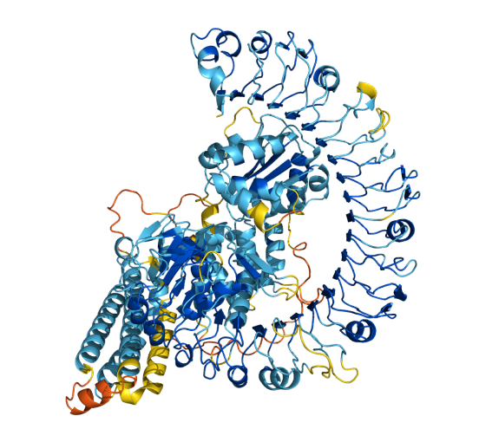

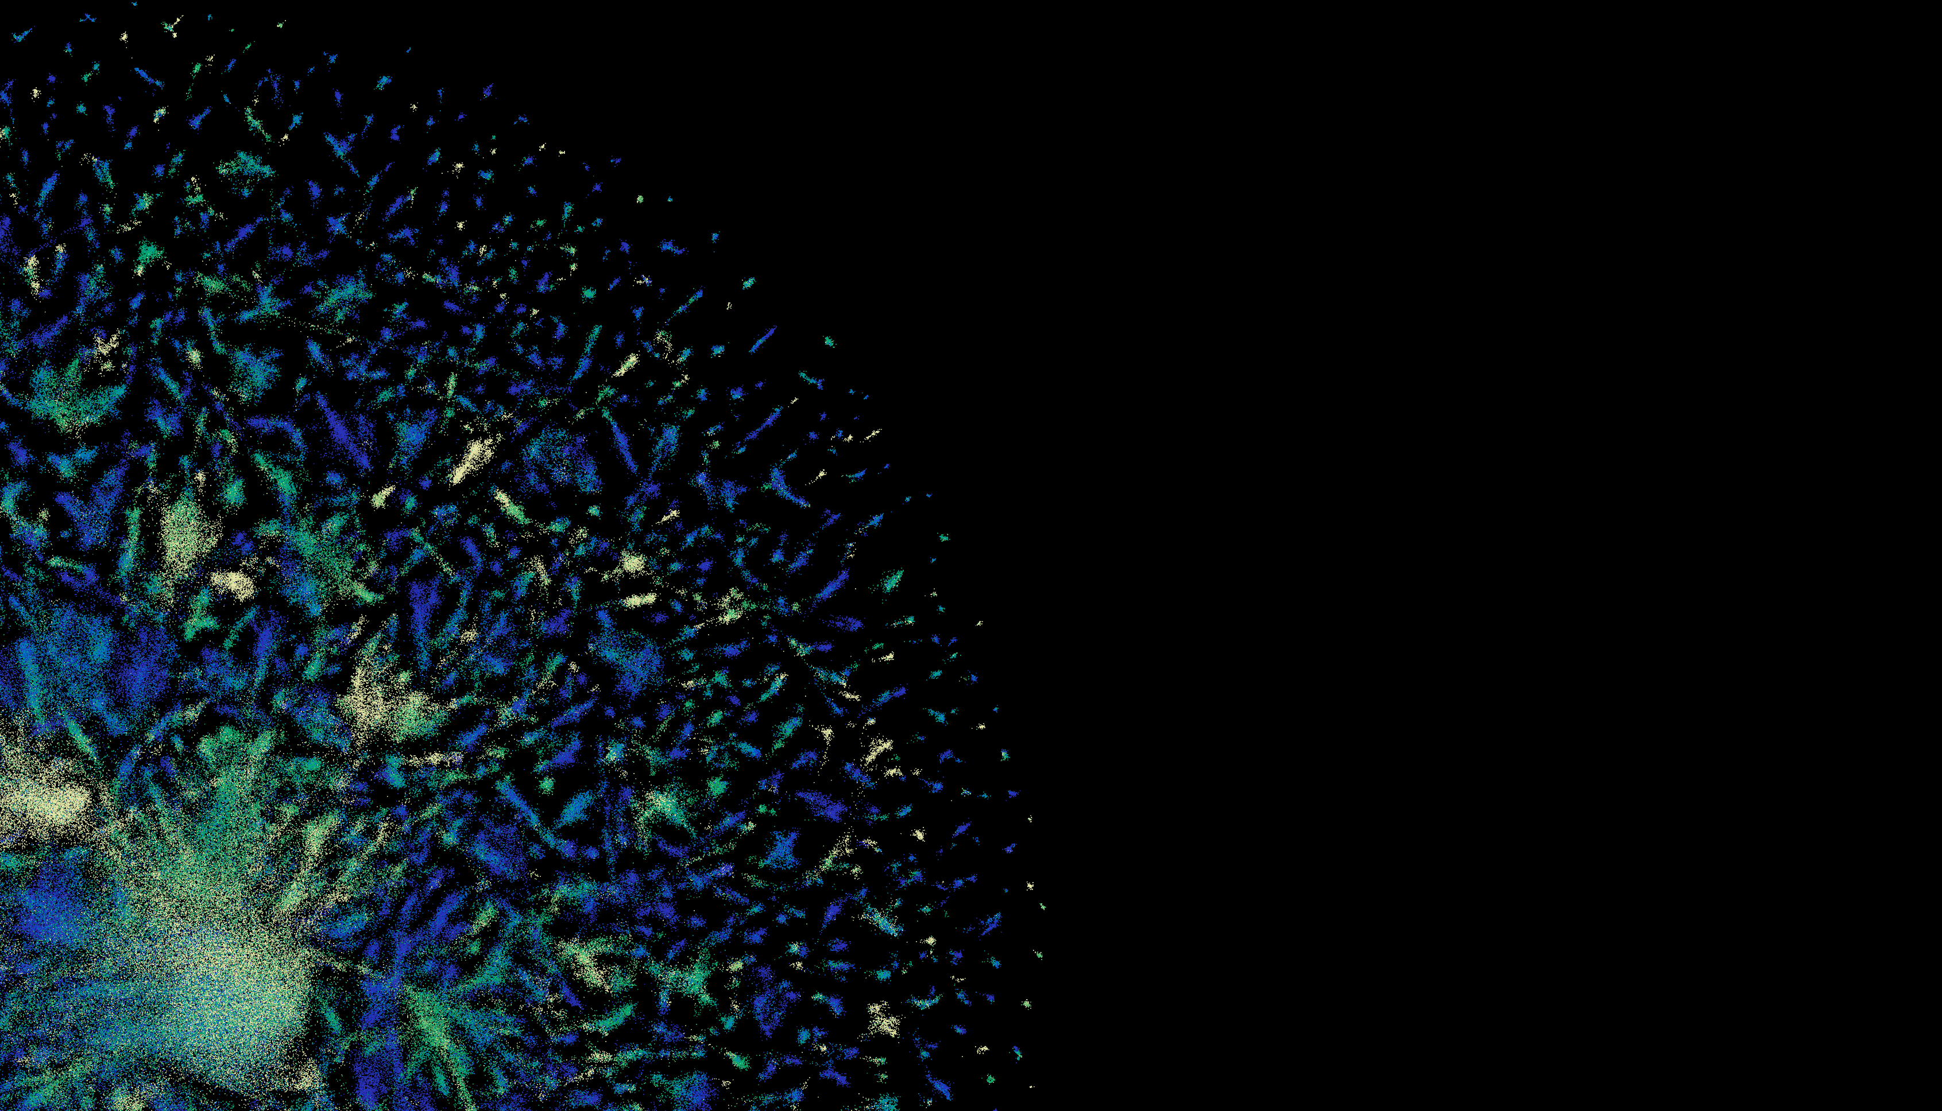


AlphaFold – algos & scale – method always beats hardware
HPC & Hyperscalers: Batch, O(N²) VRAM, O(N³) time, fixed DBs, 1000s calcs, fast I/O
'Evo'formers (GPU+CPU+DBs)
Protein-LMs (GPU)
(Alpha|Open|RoseTTA|Boltz)Fold
ESMFold, ProtTrans
Sequence alignment is the rate limiting step!
(Applies to genomics too)
We can't keep GPUs busy! They are so fast
GPU calculations x50 faster than CPU. 2 hrs vs 5 days
ESMFold is pure GPU. AlphaFold GPU+CPU+DB retrieval.
613 proteome 8 hrs vs 22 days. 4,622 protoeome 10 days vs ?? (2 years)

Slide 8
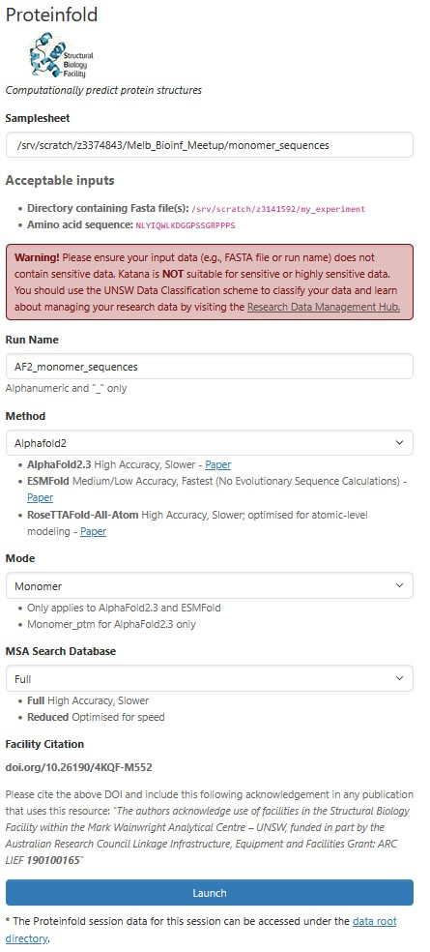
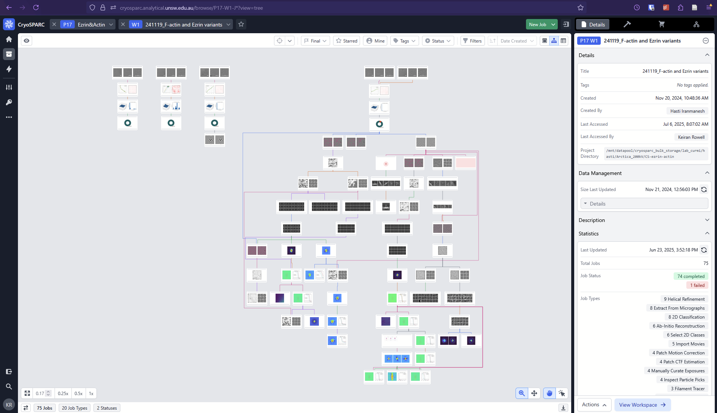
Domain experts want a single pane of glass
Interfaces rolled out by the SBF @UNSW
Access:
control lists
Portal:
OpenOnDemand
HTML / JS (?)
Pipeline:
nf-core/proteinfold
Collab:
CRG (Barcelona)
SBF (UNSW)
BioCommons (Aus)
Master: Proxmox HA 3-node cluster
Workers: Crysoparcuser workers – rack mount GPU
Workstations: Custom CryoEM software & support – A'Tuin 4xA6000
Data storage: Current: DDN -> TrueNAS (replica on ResTech server)
Planned: IBM ESS flash + HDD back-up. TrueNAS as replica?
kod.restech.unsw.edu.au/pun/sys/dashboard/batch_connect/sys/sbf_proteinfold/
cryosparc.analytical.unsw.edu.au

Slide 9
Questions / Discussion

